Slide 1

Chalet Rental Platform: A Seamless Online Booking Experience
A platform offering a smooth online booking experience for chalet rentals, built with Laravel for seamless integration.
Hello, we are Team (Team Name). We present a chalet rental platform that provides a seamless experience for lessors and renters. It features an integrated online booking system using Laravel.

Slide 2
Platform Overview
Lessors
Renters
Admins
Add chalets, set prices, and manage bookings easily.
Search chalets, view details, book, and pay online securely.
Manage users, chalets, and bookings to ensure quality.

Slide 3




User Roles and Functionalities
Lessors
Renters
Admins
Add chalets & manage bookings.
Search, book, pay & review.
Manage users & system.

Slide 4

Key Platform Features
1
Chalet Management
2
Advanced Search
Lessors can easily add and manage their chalet listings.
Renters can filter by location, price, and availability.
3
Secure Booking
4
Reviews and Ratings
Online booking and payment through trusted gateways.
Renters can leave reviews to help build trust.

Slide 5

Technology Stack
Laravel 10
PHP framework following MVC architecture.
HTML5, CSS3, JavaScript
Frontend design with Bootstrap for responsiveness.
MySQL
Database to manage chalets, bookings, and users.
Laravel Validation
Ensuring input accuracy and security.

Slide 6
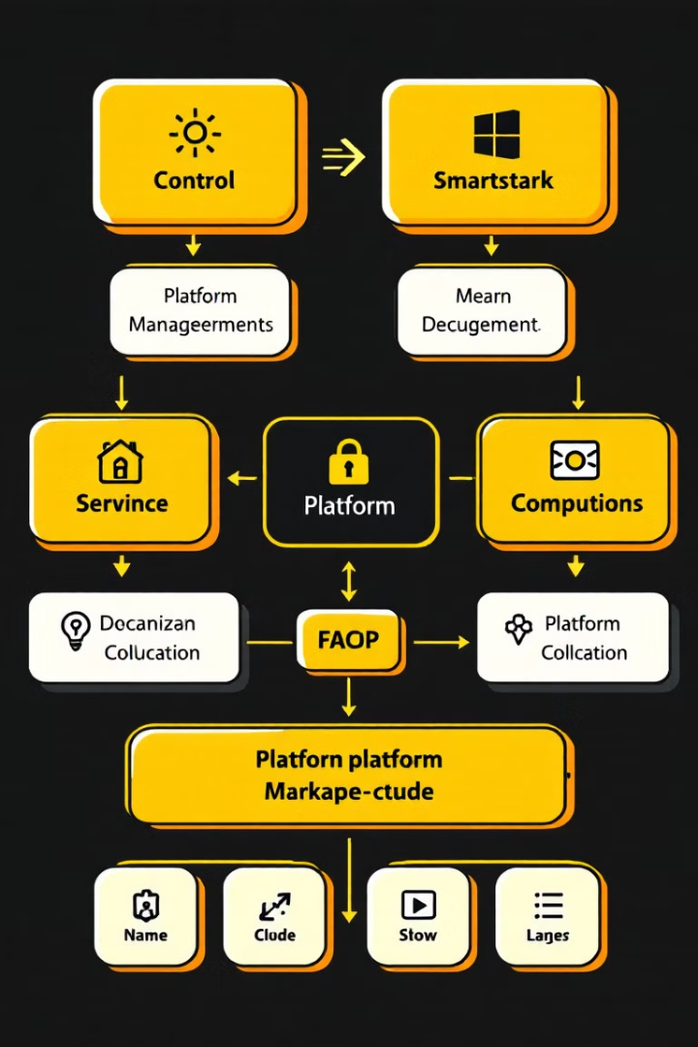



Platform Architecture
Frontend
User interface for interaction.
Backend
Laravel framework for logic and data.
Database
MySQL for data storage and management.

Slide 7

Responsive Design
Seamless access from mobile phones, tablets, and desktops is guaranteed. Our combination of modern technologies and a user-friendly interface leads to an efficient and secure rental experience.

Slide 8



Key Benefits
1
Seamless Experience
2
Efficient Management
3
Secure Booking
Our innovative platform offers a seamless and secure booking experience. Renters can browse properties, book them effortlessly, and pay online. Property owners can efficiently list and manage their properties.

Slide 9


Thank You!
This project represents a new step in online rentals. We hope to have answered all your questions. Thank you for your time.

